Slide 1
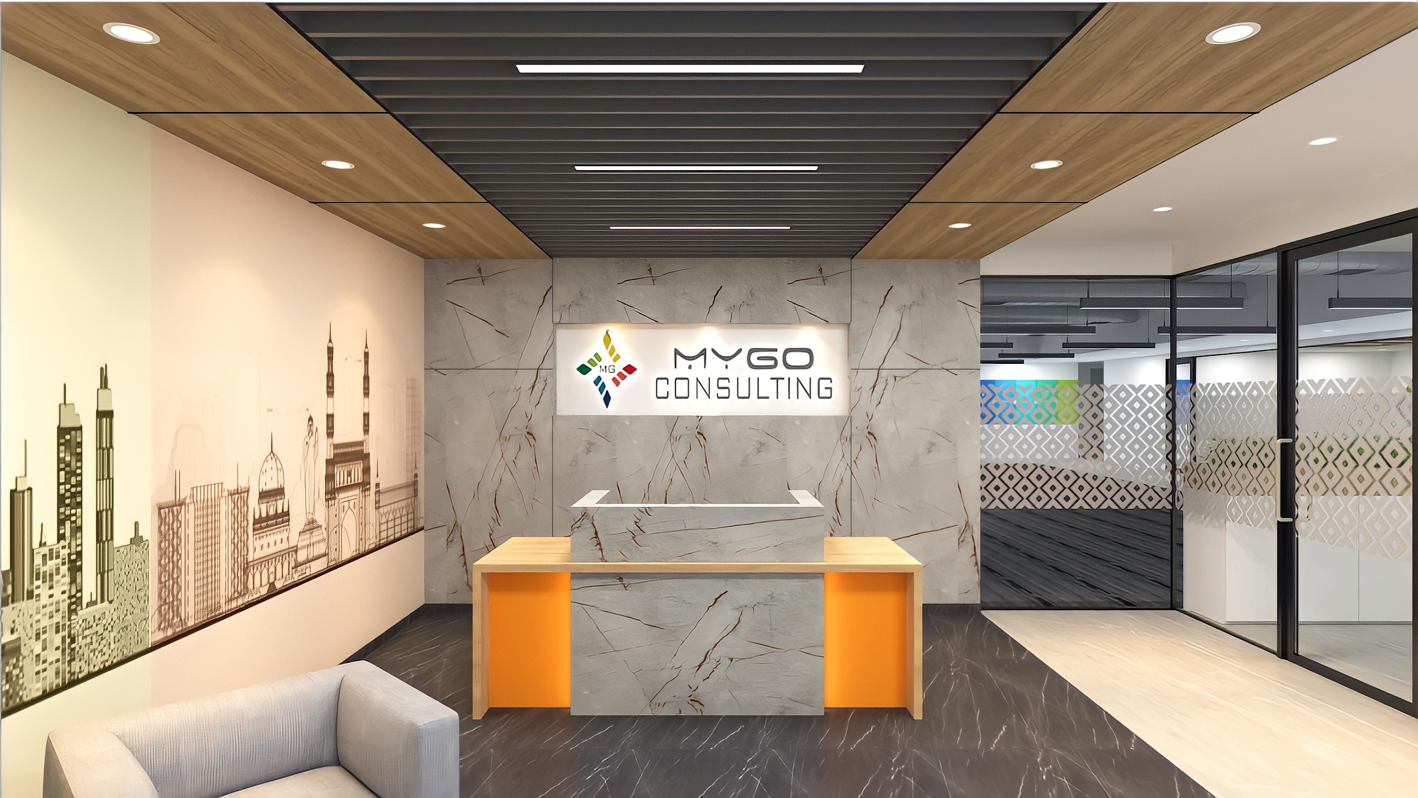
Shaping the Future of your Enterprise with SAP Integration Suite and Business AI
Think SAP Think Mygo

Slide 2
Mygo is pleased to invite you to this 1-day invitation-only event in Chicago on February 26, 2025
Attending this Virtual Event will enable you to:
Gain competitive advantage with SAP BTP Integration Suite as a vital component of keeping the core clean, establish efficient enterprise by allowing most companies to
Discover how SAP BTP AI products revolutionize business operations through intelligent digital assistants, automated document processing, and custom AI solutions for ERP use cases, with real-world examples and success stories.
Learn to leverage Large Language Models (LLMs) and master prompt engineering using Gen AI Hub, while exploring advanced semantic search and data analysis capabilities with HANA Cloud Vector Engine to create powerful AI-driven applications
Learn how customers are using advanced insights and data-driven decision tools with confidence for all area of your organization and how they combine for a holistic benefit across the SAP Business Technology Platform.
Get insights on how to improve your processes to increase employee retention, improve customer experience, and reduce cost through SAP Business Technology Platform

Slide 3
Agenda February 26, 2025
Time |  | Topics Day 1 – Creating the Generative FRE Enterprise |  | Dur.
08:30 am |  | Breakfast | Registration | Reception |  | 30 min
09:00 am |  | Welcome & Keynote – The power of BTP to enable digital transformation (Customer Success Story & Use Cases (Commscope) |  | 30 min
09:30 am |  | Introduction to Integration Capabilities – Raj Chintam - Solution Expert, SAP BTP Intelligent Adoption & Consumption team SAP Integration Suite is an industry-leading and enterprise-grade integration platform-as-a-service that helps businesses seamlessly connect and integrate their applications, data, and processes within their organization and beyond. A starter collection of pre-built, best-practice integration packs helps integration developers achieve faster time to value. Execute the integration content on the Business Technology Platform or within your private landscape During this session, participants can get an overview of the SAP Integration Suite, its development environment, concepts, capabilities, and the value proposition |  | 45 min
10:15 am |  | Break |  | 15 min
10:30 am |  | AI-Driven Business Solutions - Exploring the potential SAP BTP AI Jay Xiong - Solution Architect, SAP BTP AI In today's fast-paced digital landscape, businesses face many challenges that can hinder growth and efficiency. These include but are not limited to the need for interactive intelligent digital assistants for faster information retrieval and transaction processing, scaling AI operations at low cost, automating business document processing, extracting insights from unstructured customer feedback, boosting developer productivity, streamlining integration flows, and automating complex business and IT workflows. Without AI, these tasks can be time-consuming, error-prone, and resource-intensive, impacting your bottom line. This session reveals how SAP BTP AI products transform challenges into opportunities. Starting with a portfolio overview, we'll explore real-world use cases. Discover how Joule enhances user experiences, and how our AI automates document processing, analyzes sales orders, and how to create custom AI solutions for various classic ERP use cases. Customer success stories and solution architectures will provide tangible insights into SAP BTP AI's transformative power. |  | 60 min
11:30 am |  | Tricentis: Accelerating Value Delivery with Tricentis, SAP, and Mygo Consulting Discover how Tricentis and Mygo Consulting drive digital transformation through intelligent software quality excellence. This session explores how our partnership accelerates SAP transformations with advanced test automation, ensuring seamless integrations and faster time-to-market. Bill Ross - Regional Sales Director for the North Central region at Tricentis |  | 30 min
12:00 pm |  | Mygo Presentation - Exploring Global SAP BTP Initiatives: Real-World Implementations and Insights Learn how Mygo Consulting has successfully operationalized the SAP Business Technology Platform (BTP) for customers across industries. This session will highlight real-world implementations, key challenges, and best practices that have driven success. Discover how organizations leverage BTP to foster innovation, enhance user experiences, and optimize operations. Gain actionable insights from our experience in SAP Fiori App Development, WorkZone for Public Cloud, enterprise integrations, SAP CALM, and more. Trinath Peravali - SAP Solution Architect at Mygo |  | 30 min
12:30 pm |  | Lunch & Networking |  | 45 min
1:15 pm |  | Unlocking Advanced BTP Gen AI Capabilities – A Deep Dive into BTP Gen AI Hub and HANA Cloud Vector Engine​ Jay Xiong - Solution Architect, SAP BTP AI Kevin Li – Solution Expert, SAP BTP Adoption & Consumption team | End-to-end integration business use case Raj Chintam - Solution Expert, SAP BTP Intelligent Adoption & Consumption team Rao Addanki - Director at SAP | 90 min
2:45 pm |  | Break |  | 15 min
3:00 pm |  | Customer Panel |  | 45 min
4:00 pm |  | Wrap-up Day 1 / Closing |  | 15 min
4:15 pm |  | Networking Reception |  | 45 min

Slide 4
Agenda February 26, 2025
Time |  | Breakout Session Topics |  | Dur.
1:15 pm |  | Unlocking Advanced BTP Gen AI Capabilities – A Deep Dive into BTP Gen AI Hub and HANA Cloud Vector Engine​ Jay Xiong - Solution Architect, SAP BTP AI Kevin Li – Solution Expert, SAP BTP Adoption & Consumption team In the rapidly evolving landscape of enterprise AI, businesses face significant challenges in effectively leveraging large language models (LLMs) and handling complex, unstructured data. Traditional approaches often lack the flexibility to integrate cutting-edge AI capabilities into existing business processes, while also struggling to perform advanced semantic searches and analytics on vast amounts of data. Join us to: Harness the power of large language models (LLMs): Learn to access, deploy, and manage various LLMs through the Gen AI Hub for tasks such as text generation, summarization, and analysis. Master prompt engineering: Develop skills to craft effective prompts that maximize the potential of LLMs for your specific business needs. Explore vector-based data analysis: Discover how HANA Cloud's Vector Engine enables advanced semantic search and similarity analysis on large datasets. Integrate AI into business processes: Learn to combine the capabilities of Gen AI Hub and Vector Engine to create intelligent, AI-driven applications. Target Audience: SAP Solution Architects Data Scientists AI Engineers Prerequisites: Basic knowledge about SAP BTP Hands-on experience with data science, Python Basic understanding of Generative AI | End-to-end integration business use case Raj Chintam - Solution Expert, SAP BTP Intelligent Adoption & Consumption team Rao Addanki - Director at SAP The purpose of the workshop is to get a deeper understanding of SAP Integration Suite by exploring its capabilities in a Hands-on fashion. You will implement real-life Digital Integration Hub scenario by: configuring a flow to trigger events from SAP SuccessFactors using Event Driven Architecture and consume events them in SAP Cloud Integration. Why Attend Get an architectural overview of SAP Integration Suite and the functionality of its capabilities . Acquire Hands-on experience by designing messages queues in SAP Event Mesh, configuring artifacts in Cloud Integration, explore monitoring options, understand options available to inspect system resources like processing memory, storage space, JMS queues, understand log retention duration policies, log archival mechanism, User access control policies, audit log etc. Complexity: Intermediate/Beginner Audience: Decision Makers, Architects, SMEs. Prerequisites: None. | 90 min

Slide 5
Toros Aledjian
Senior Director BTP Solutions and Enablement
toros.aledjian@mygoconsulting.com
M: (347) 514-5120

